Slide 1
Lecture-
Chapter 7: Series-Parallel Circuits
Abu Ahmed Ferdaus, CSE, DU.

Slide 2
This Lecture Includes:
Objectives
7.1 Introduction
7.2 Series-Parallel Networks
7.3 Reduce and Return Approach
7.4 Block Diagram Approach
7.6 Ladder Network
Abu Ahmed Ferdaus, CSE, DU.

Slide 3
Objectives
Learn about the unique characteristics of series-parallel configurations and how to solve for the voltage, current, or power to any individual element or combination of elements.
Become familiar with the voltage divider supply and the conditions needed to use it effectively.
Learn how to use a potentiometer to control the voltage across any given load.
Abu Ahmed Ferdaus, CSE, DU.

Slide 4
7.1 Introduction
series and parallel circuits form a foundation for simple network configuration. In broad terms, the remaining possibilities as either series-parallel or complex configuration.
A series-parallel configuration is one that is formed by a combination of series and parallel elements.
A complex configuration is one in which none of the elements are in series or parallel.
There are no new laws or rules to learn—simply an approach that permits the analysis of such structures.
The possibilities for series-parallel configurations are infinite. Therefore, you need to examine each network as a separate entity and define the approach that provides the best path to determining the unknown quantities.
Abu Ahmed Ferdaus, CSE, DU.

Slide 5
7.2 Series-Parallel Networks
Two elements are in series if
1. They have only one terminal in common (i.e., one lead of one is connected to only one lead of the other).
2. The common point between the two elements is not connected to another current-carrying element.
Two elements, branches, or networks are in parallel if they have two points in common.
In a series-parallel network, you must be very careful to determine which elements are in series and which are in parallel.
Abu Ahmed Ferdaus, CSE, DU.

Slide 6
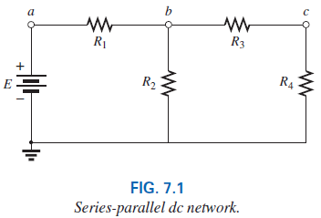
7.2 Series-Parallel Networks
Resistors R₁ and R₂ are not in series due to resistor R₃ connected to the common point b between R₁ and R₂
Resistors R₂ and R₄ are not in parallel because they are not connected at both ends. They are separated at one end by resistor R₃.
Abu Ahmed Ferdaus, CSE, DU.

Slide 7
7.2 Series-Parallel Networks
the two resistors R₃ and R₄ are in series because they share only point c, and no other element is connected to that point.
Further, the voltage source E and resistor R₁ are in series because they share point a, with no other elements connected to the same point.
In the entire configuration, there are no two elements in parallel.
Abu Ahmed Ferdaus, CSE, DU.

Slide 8
7.2 How do we analyze such configurations?
General Approach:
1. Take a moment to study the problem “in total” and make a brief mental sketch of the overall approach you plan to use. The result may be time- and energy-saving shortcuts.
2. Examine each region of the network independently before tying them together in series-parallel combinations. This usually simplifies the network and possibly reveals a direct approach toward obtaining one or more desired unknowns. It also eliminates many of the errors that may result due to the lack of a systematic approach.
Abu Ahmed Ferdaus, CSE, DU.

Slide 9
7.2 How do we analyze such configurations?
3. Redraw the network as often as possible with the reduced branches and undisturbed unknown quantities to maintain clarity and provide the reduced networks for the trip back to unknown quantities from the source.
4. When you have a solution, check that it is reasonable by considering the magnitudes of the energy source and the elements in the network. If it does not seem reasonable, either solve the circuit using another approach or review your calculations.
Approaches to Solve the Networks:
1. Reduce and Return Approach
2. Block Diagram Approach
Abu Ahmed Ferdaus, CSE, DU.

Slide 10
7.3 Reduce and Return Approach
This process enables you to reduce the network to its simplest form across the source and then determine the source current.
In the return phase, you use the resulting source current to work back to the desired unknown.
For most single-source series-parallel networks, the above approach provides a viable option toward the solution.
In some cases, shortcuts can be applied that save some time and energy.
Fig. 7.2 (Reduce and Return Approach)
Examples: Example 7.1, 7.2
Abu Ahmed Ferdaus, CSE, DU.

Slide 11
7.4 Block Diagram Approach
Occasionally reduce and return approach is not as obvious, and you may need to look at groups of elements rather than the individual components.
Once the grouping of elements reveals the most direct approach, you can examine the impact of the individual components in each group.
This grouping of elements is called the block diagram approach.
For series resistors R₁ and R₂, a comma is inserted between their subscript notations: R_{1,2} = R₁ + R₂
For parallel resistors R₁ and R₂, the parallel symbol is inserted between their subscripted notations: R_{1||2} = R₁ || R₂
Abu Ahmed Ferdaus, CSE, DU.

Slide 12
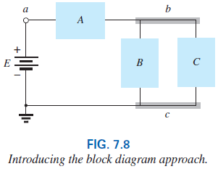
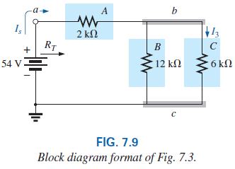
7.4 Block Diagram Approach
Abu Ahmed Ferdaus, CSE, DU.

Slide 13
7.5 Descriptive Examples
Example: 7.3
Example: 7.4
Example: 7.5
Example: 7.6
Example: 7.7
Example: 7.8
Example: 7.9
Example: 7.10
Example: 7.11
Abu Ahmed Ferdaus, CSE, DU.

Slide 14
7.5 Ladder Network
A three-section ladder network appears in Fig. 7.32. The reason for the terminology is quite obvious for the repetitive structure. Basically two approaches are used to solve networks of this type.
Method 1: Calculate the total resistance and resulting source current, and then work back through the ladder until the desired current or voltage is obtained.
Method 2: Assign a letter symbol to the last branch current and work back through the network to the source, maintaining this assigned current or other current of interest. The desired current can then be found directly.
Abu Ahmed Ferdaus, CSE, DU.

Slide 15
To be continued….
Abu Ahmed Ferdaus, CSE, DU.

